Slide 1
Council of Supply Chain
Management Professionals
March 15, 2017
Raw Material
Purchasing
Manufacturer’s DC
Customer’s DC
Factory
Consumer
Rick D. Blasgen
President & CEO
CSCMP

Slide 2



A Professional Association
Evolution and Relevancy
SCOPE, SCALE, IMPACT
2004
1985
1963
  Council of Supply Chain Management Professionals
  Council of Logistics Management
  National Council of Physical Distribution Management

Slide 3
CSCMP – What You can Experience!
EDUCATION
CAREER RESOURCES
CONNECTIONS
NETWORKING
RESEARCH
Notes:
The goal is to create learning….
Discuss how customized content is developed from beginning/meeting with J&J before content is created.

Slide 4
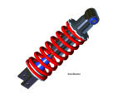
What is a Supply Chain?

Slide 5









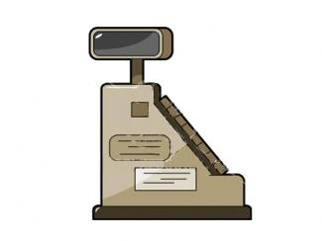
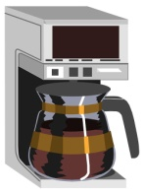

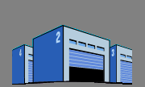


A Typical Supply Chain
Product
Sourcing
Customer
Order
Receipt
Storage
Manufacture
Storage
Distributor
Retailer
Supplier
Storage
Manufacturer
Storage
Distributor
Retailer
End User
People
Technologies
Processes

Slide 6
Evolutionary Perspective
More Attention
From Senior
Management
Focus
Supply Chain
Management- We became Global!
Functional Orientation
Purchasing
Operations
Marketing
Package Engineering
Transportation
Inventory Mgt.
Warehousing
Manufacturing
Suppliers
Customers
etc.
Logistics
1950
1960
1970
1980
1990
2000
Beyond

Slide 7
Transparency!

Slide 8
Our nation’s freight transportation system is a vast, complex network of almost seven million miles of highways and local roads, railways, navigable waterways, and pipelines.

Slide 9


Underinvestment in the Freight System

Slide 10

State of Logistics Report 2016
CSCMP
Report Release
June 21, 2016

Slide 11

US Business Logistics Costs totaled
$1.4 Trillion in 2015
US business logistics costs
$ billion
5.1% CAGR
2.6%
Notes:
IN 2015 USBLC GREW 2.6% TO $1.4 TRILLION
THIS IS A SIGNIFICANTLY SLOWER PACE [CLICK] THAN THE 5.1% ANNUAL RATE FROM 2010 TO 2014
AS WE’LL GET INTO, THIS IS LARGELY THE RESULT OF TRENDS IN VOLUMES AND RATES ACROSS VARIOUS MODES

Slide 12
As a percentage of GDP, USBLC declined
6 basis points to 7.85%
US business logistics costs as a share of nominal GDP (%)
-6 bp
Note: bp is basis points.
Source: CSCMP’s 27th Annual State of Logistics Report (see report appendix)
Notes:
AS NOMINAL GDP GREW 3.5%, USBLC DECLINED 6 BASIS POINTS TO 7.85% OF GDP
CONTINUING TO HOVER AT 5 YEAR TREND OF ~ 7.9% OF GDP
WHILE THIS REFLECTS AN IMPROVEMENT IN LOGISTICS EFFICIENCY (COST RATIO), IT IS IMPORTANT TO EXPLORE THE VARIOUS FACTORS UNDERPINNING USBLC COST CHANGES

Slide 13

After 5 years of increases, inventory
levels declined in 2015
Total US private inventories
$ billion
2,459
2016
YTD
Note: Total US private inventories includes manufacturing, retail, and wholesale and represents stock or goods available for sale . Annual numbers are the yearly average.
Source: Bureau of Economic Analysis
Notes:
As an opening point it is important to distinguish
Total business inventory (TBI): the absolute value of inventory held
Inventory carrying costs (ICC): reflects the cost of holding inventory; the sum of storage costs, cost of capital (Total business inventory value * weighted average cost capital (WACC)) << e.g., the cost to finance inventory>>, and other costs (insurance, obsolescence, etc.).
Inventory levels had been rising @ ~5% (’09 to ’14), but DECLINED 2% IN ’15 (NOTE THIS IS A DOWNWARD REVISION FROM THE REPORT EARLIER THIS YEAR). DECLINE DRIVEN BY TWO SECTORS, FARMING AND NONDURABLE GOODS
Early in the year there was discussion that this inventory trend was portending a negative turn in the economy
However, What we believe is that this reflects an increased focus on cash and a total cost perspective to supply chain decisions
over the prior 5 years (2010 to 2014), inventory levels (TBI) grew at an annual rate of 5.4%. This was faster than the rate of GDP growth during the same period. As a result TBI grew from 13.6% of GDP to 14.5% of GDP.
If you recall my earlier comments, 2010 to 2014 was period of declining wacc. Conclusion, inventory was cheap and companies focused on minimizing other cost elements (e.g., manufacturing costs, transportation)
However, in 2015 as transportation costs declined and inventory became more expensive, companies pulled back on inventory; levels flattened – despite continued GDP growth, and TBI as % of GDP declined to 14.0%; harkening back to pre-Great Recession levels,
[CLICK] THIS DOWNWARD TREND CONTINUED IN THE FIRST HALF OF 2016
Looking forward: Increasing costs to hold inventory (WACC and warehousing), coupled with uncertainty regarding the US economy will result in companies continuing to become more efficient (lean) in their deployment of inventory and we would expect inventory levels (TBI) to remain flat or trend down as a percent of GDP. PARTICULARLY IF MOTOR VEHICLE INVENTORY, ONE OF THE FEW SECTORS REFLECTING INCREASED INVENTORY, PULLS BACK
However, any upward pressure on WACC (e.g., Fed Rate) and warehousing costs (WHICH REMAIN STRONG ON INCREASED ABSORPTION WITH RATES UP 6.6% YEAR-OVER-YEAR) will likely offset this reduction and net an increase in ICC as % GDP
Successful companies will overcome siloed metrics and focus on total landed cost (materials plus manufacturing plus transportation plus inventory carrying costs) to ensure they make the right tradeoffs in a volatile market

Slide 14
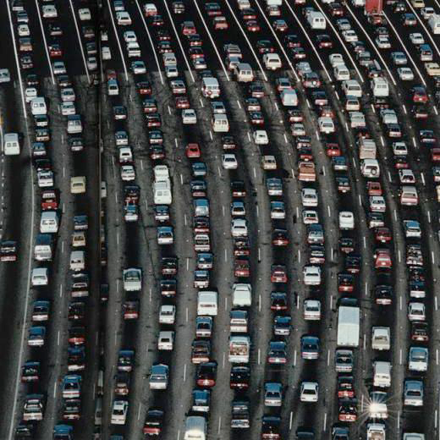
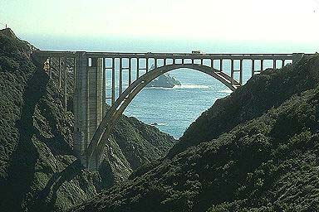
Highways…
8,420,589 lane miles, 46,630 Interstate highway miles
3,014,116 million vehicle miles traveled (VMT)
599,766 road bridges

Slide 15

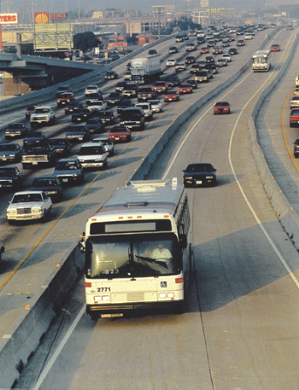
Transit…
7,700 public transit agencies
53,353 million passenger miles on public transit

Slide 16

Truck tonnage flattened in 2015,
after rising more than 7% during 2014
Truck Tonnage Index
Seasonally adjusted monthly values (2000 [index year]= 100)
+7.2%
+1.9%
2014
2015
2016
Source: Bureau of Transportation Statistics
Notes:
$583 billion in revenue, and employs more than 7 million [America Truck Association]
TRUCK TONNAGE: Following steep rise in 2015, tonnage was flat in 2016 [Bureau of Transportation Statistics]
[CLICK]
AND HAS CONTINUED FLAT IN THE FIRST HALF OF 2016
[CLICK]
WHILE A JULY UPTICK COULD PORTEND A RECOVERY, most discussions reflect improvement, but at a moderate pace

Slide 17
Truck tonnage remained flat in the
first half of 2016…
Truck Tonnage Index
Seasonally adjusted monthly values (2000 [index year]= 100)
+7.2%
+1.9%
Flat
2014
2015
2016
Source: Bureau of Transportation Statistics
Notes:
$583 billion in revenue, and employs more than 7 million [America Truck Association]
TRUCK TONNAGE: Following steep rise in 2015, tonnage was flat in 2016 [Bureau of Transportation Statistics]
[CLICK]
AND HAS CONTINUED FLAT IN THE FIRST HALF OF 2016
[CLICK]
WHILE A JULY UPTICK COULD PORTEND A RECOVERY, most discussions reflect improvement, but at a moderate pace

Slide 18

For motor carriers 2015 was a year of
rate weakness
Dry van spot market rates
$ per mile
The rate decline was driven by additional capacity and trucking companies pursuing lower-yield traffic such as intermodal and LTL
The Cass Freight Index confirms the declining rate trend
Carriers largely responded by improving operational efficiency and holding back on fleet orders
-17%
-21%
-27%
2015
Week
2016
Note: Includes fuel.
Source: Truckstop.com
Notes:
2015 characterized by overcapacity on soft tonnage, driving down rates after years of rising prices.
Began weak and declined as year progressed
While 2016 YTD spot rates are still averaging 10% below 2015, rates have increased relative to first quarter lows
TRUCK ORDERS: Carriers looking to adjust capacity reduced investment in new equipment as Class 8 net orders fell 24% from 376,000 units in 2014 to 284,000 units in 2015 [FTR Associates] YTD orders are running 40% lower than 2015
SPECIALIZED TRUCKING:
DEDICATED a bright spot. Efficiency and service in complex networks
LTL: Mixed. Several large saw declines in revenue and tonnage, while others maintained and slightly grew. Stable pricing and many investing in dimensional scanning to help maintain pricing discipline. While rates are holding, tonnage remains soft
On topic of DRIVER SHORTAGE: Despite softening, competition for drivers is intense. Since 2010 demand for drivers has risen from 1.5 million to approaching 1.7 million today [Bureau of Labor Statistics].
While BLS reflects a 2% wage increase, interviews suggest higher wages than reported.
Drug testing, electronic logging, and other factors will put pressure on labor pool
To appease drivers, carriers increasingly prioritizing “friendly” freight and shippers
FUEL: US on-highway diesel fuel prices, declined nearly 30% during 2015 from $3.137 to $2.237 per gallon according to EIA – average $2.71. forecasting (september report) $2.31 in 2016 and $2.70 in 2017

Slide 19







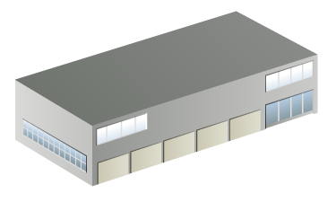



Web Site
Brick and Mortar Stores
Tablet/Mobile
Catalogs
Order from Anywhere
Call Center
Flash Sales
Customer
Fulfill from Anywhere
Retail DC(s)
Kiosk
eCommerce DC(s)
Pop-Up Stores
Brick and Mortar Stores
Outlet Locations

Slide 20
eCommerce is an estimated $440 B market, forecasted to grow 12% per year over the next three years
US eCommerce Sales by Year ($B)
Estimated 2016 eCommerce sales of $440 B
2012 to 2016 eCommerce sales CAGR of 15%
eCommerce sales forecasted to grow by 12% per year 2015 to 2018
eCommerce sales accounted for about 7.3% of total 2015 retail sales
  9.4% of retail sales excluding autos, fuel
Traditional retailing is still vast majority of market
Source: Internet Retailer; US Census Bureau; Statista
Information provided by Transportation and Logistics Advisors, LLC

Slide 21
Supply chain costs are an estimated 25% to 30% of the total eCommerce sales
Est. 2016 US eCommerce Sales Cost Buildup Total $440 B
Est. eCommerce Supply Chain Cost
Category | % Sales | Spend ($B)
Inbound | 4-6% | $17-$26
Fulfillment | 5% | $22
Inventory | 6% | $26
Outbound | 6%-9% | $26-$40
Returns | 4.5% | $20
TOTAL Supply Chain | 25.5% - 30.5% | $112 - $134
Supply Chain
25%-30%
Assumes a well run supply chain
If sub-optimal, costs escalate – fast!
Source: US Census Bureau; TandLA experience and model estimates

Slide 22
Black Friday’s $9B Haul Shatters Records
Sales - $3.34 B, up 21%
Thanksgiving Day - $1.93B
Mobile Revenue surpassed $1B for first time
Cyber Monday expected $3.36B, up 9.4%
Notes:
From “CPFR emerges as the next Movement in Supply Chain Management” by Joseph C. Andraski, VICS-CPFR, and OMI International
Obstacles to Collaboration Persist [Extract]
Lack of internal alignment with regard to corporate goals and objectives that support a company/s commitments to its stakeholders and shareholders.
Compensation that promotes a silo mentality
Non-existent change management skills
Tunnel vision
“not invented here” mentality
Internally focused organizational silos
Legacy systems
Leadership focused on Wall Street and making the numbers regardless of the expense to the long term prospects of the company.
Personal comfort zones
“my business is different and its unique characteristics demand that the status quo must be maintained.”

Slide 23

Parcel and express: Fueled by B2C
Parcel and Express Transportation
$ billions
USPS
6.7% CAGR
Main drivers of growth are e-commerce and omnichannel retail, which challenge operating models in last-mile delivery and reverse logistics
Challenge: B2C shipments generate lower-than-average revenue and have higher operating costs
Trend plays to the strengths of USPS, which saw shipping and package volume grow 14% in 2015
Couriers / Messengers
Source: A.T. Kearney analysis
Notes:
$82 billion industry (including courier and messenger)
FedEx, UPS, and USPS dominate
Two broad types of service – time-definite (e.g., next day) and deferred (ground)
8% growth in 2015
FedEx ground +9%; UPS ground +3%
Express for both flat
USPS saw shipment volume grow 14% in 2015
Reason is explosion in B2C ecommerce and omnichannel retail which Grew 14.6% in 2015 (Department of Commerce), rising to 7.3% of total retail
Trend continuing as q2 ecommerce grew 15.8% over prior year, and jumped to 8.1% of total retail
CHALLENGE: As a rule, B2C shipments generate lower revenue per shipment than average and have higher operating costs associated with residential deliveries.
Increasing number of retailers pushing on same-day from local stores, diverting volume from the market leaders.
Consumer returns also a challenge, challenging delivery density of leaders
However, may play into strength of USPS
Area of dramatic innovation ACTIONS TO ADDRESS:
Investing in robotics/automation, routing software, and partnerships with USPS – FedEx SmartPost and USPS SurePost
FedEx’s Delivery Manager and UPS Access Point and My Choice
And both looking to increase scope of services, FedEx purchase of GENCO and UPS Coyote Logistics
UPS invested in same-day start-up Deliv, similar to Postmates, crowd sources last-mile
Uber testing last mile
Retailers testing self-delivery
Amazon… into logistics

Slide 24
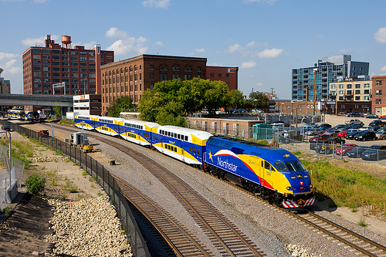
Commuter Rail
599 million rail miles traveled

Slide 25
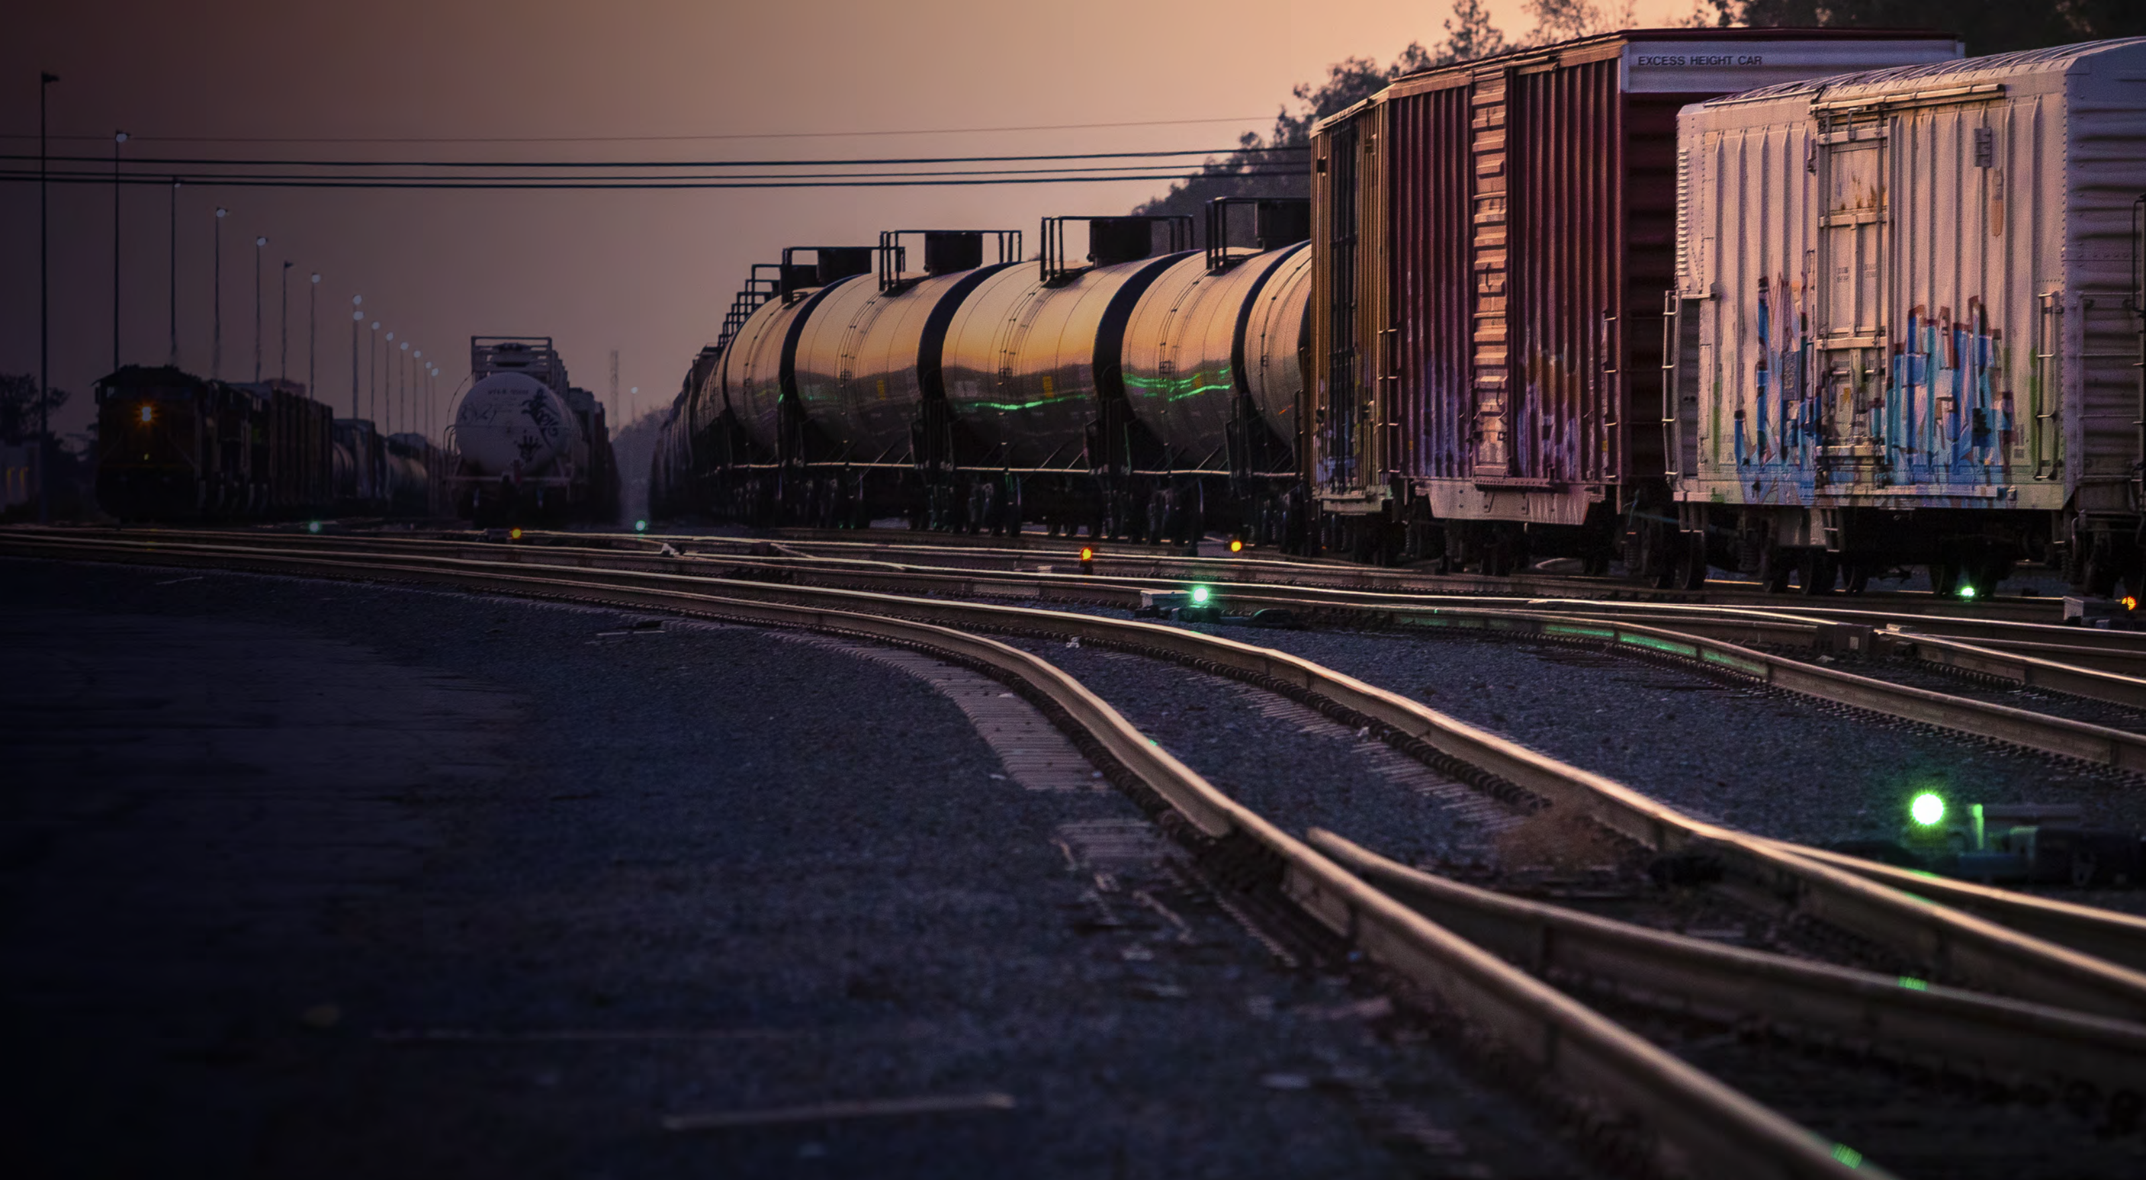
Rail: An end to “black gold”?
Coal volumes are on a downward trend,
while intermodal traffic has stalled
US Class I rail traffic
Thousand carloads
Intermodal
A steep decline in coal traffic and crude by rail, macroeconomic weakness, and a pause in the growth of intermodal traffic resulted in an overall rail volume reduction of 2.5% in 2015
The share of coal-fired electricity generation has fallen from 56% in 2000 to 33% in 2015
Coal
0%
+5% CAGR
-3% CAGR
-14%
Sources: Association of American Railroads; A.T. Kearney analysis
Notes:
140,000 mile US rail system is the largest in the world
$80 billion in revenue in 2015, AN 8.9% DECLINE OVER 2014
Employees 185,000 peoples [Association of American Railroads]
Highly concentrated, 7 Class I railroads generate 95% of revenue. And responsible for the maintenance and capital of the networks they operate
After growth of 4.5% in 2014, rail volume declined 2.5% in 2015, largely due to decline in coal and crude by rail
Decline in coal accelerated and it is clear that coal has lost importance, as the share of coal-fired electricity generation has fallen from 56% in 2000 to 33% in 2015
Intermodal growth stalled as many shippers, faced with lower fuel surcharges and lower base rates opted to move goods by truck rather than rail
Ytd both trends continue as coal carloads are 27% below and intermodal is 3% year ago

Slide 26

Air…
5,202 public use airports

Slide 27
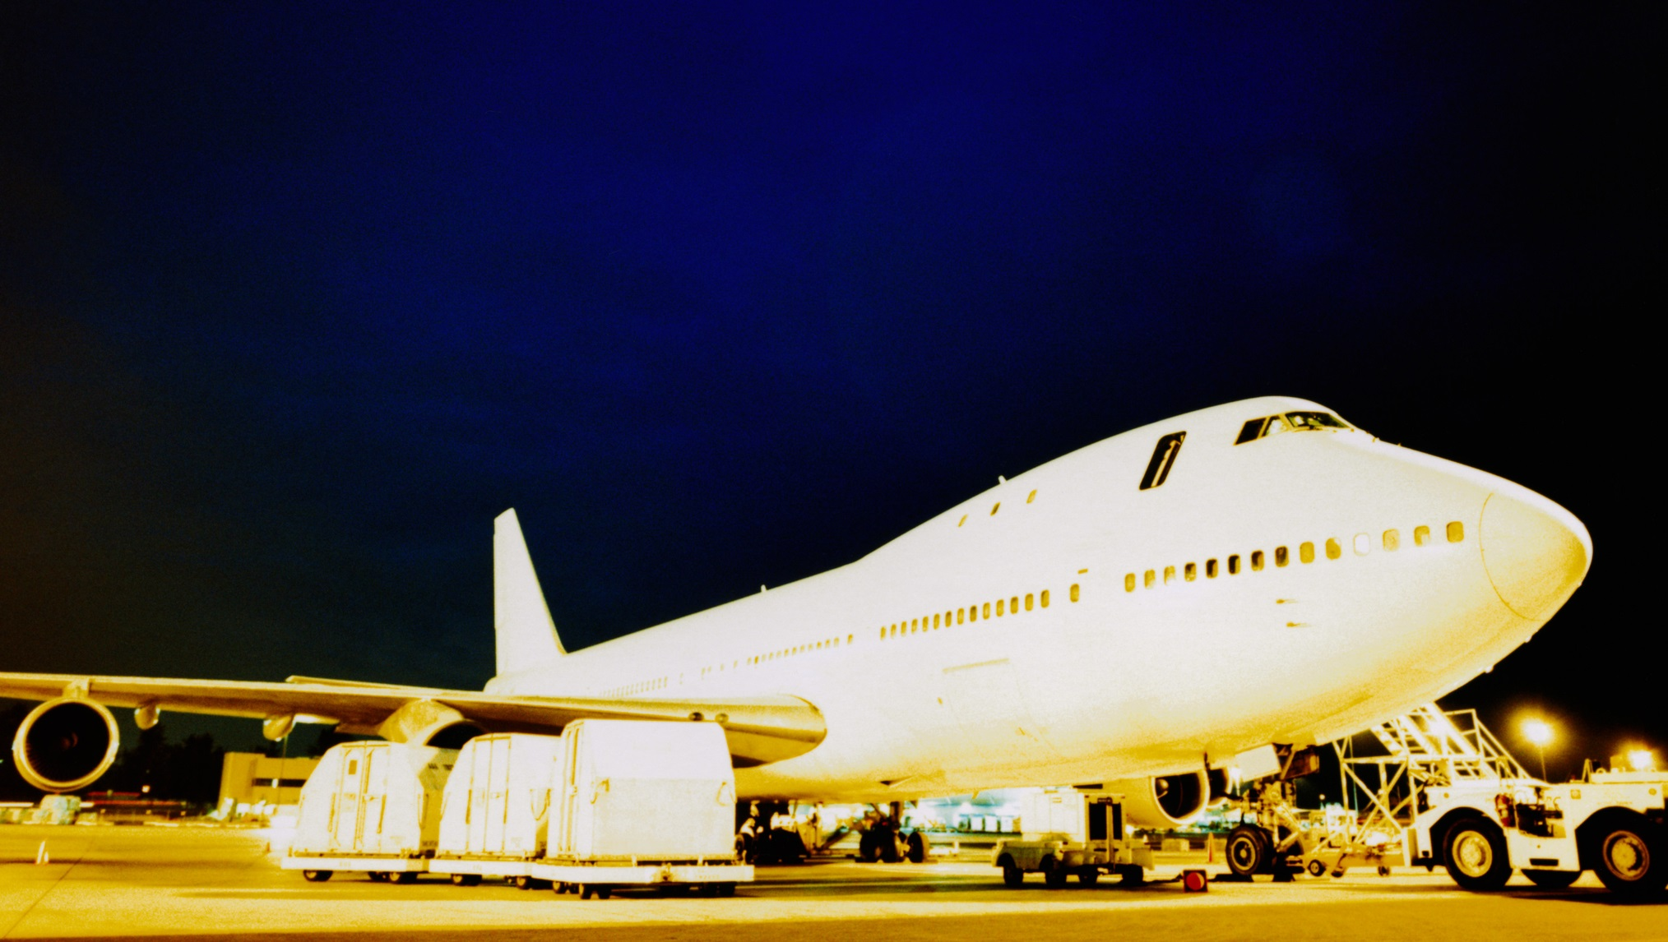
Airfreight: Overcapacity and falling rates
Drewry Air Freight Index –Shanghai to Los Angeles
$ per kilo
Passenger and cargo carriers increased 2015 capacity by 9,000 MT and 4,000 MT respectively—exacerbated by shift to wide-body aircraft
Drewry Air Freight Index from Shanghai to Los Angeles dropped 41% from 2015 peak
From January – June 2016 rates increased 22%
-41%
-28%
Note: Index shows average of all-in airfreight buy rates paid by forwarders to airlines for standard deferred airport-to-airport airfreight services.
Source: Drewry's Sea & Air Shipper Insight
Notes:
WITH 2.1% GROWTH IN 2015, AIRFREIGHT WAS VALUED AT $67 BILLION IN 2015
FOR SHIPPERS IN HIGH VALUE AND TIME SENSITIVE INDUSTRIES, INTERNATIONAL AIRFRIEGHT IS A CRITICAL LINK IN THEIR SUPPLY CHAIN. STRICTLY DOMESTIC AIRFREIGHT IS OF MARGINAL SIZE AND IMPORTANCE TO SHIPPERS
WITH DEMAND RELATIVELY SLUGGISH AND OVERCAPCITY EXACERBATED BY THE SHIFT TO WIDE-BODY AIRCRAFT BY BOTH CARGO AND PASSENGER, OVERCAPACITY IS DEPRESSING RATES, AS REFLECTED IN THE DREWRY AIR FREIGHT INDEX FROM SHANGHAI TO LOS ANGELES, WHICH DROPPED 37% BETWEEN JANUARY 2015 AND JANUARY 2016
Capacity imbalance is present across global regions and airfreight types – hazardous materials such as batteries

Slide 28
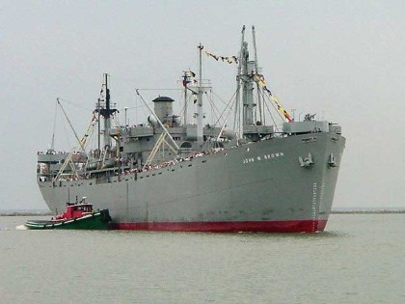
Water…
360 commercial sea and river ports
9,627 miles of inland waterways

Slide 29


Increased Global Economic Competition
Notes:
Note also the value of international freight will more than triple (the volume of freight by tonnage will more than double) between 2040 and 2012.

Slide 30
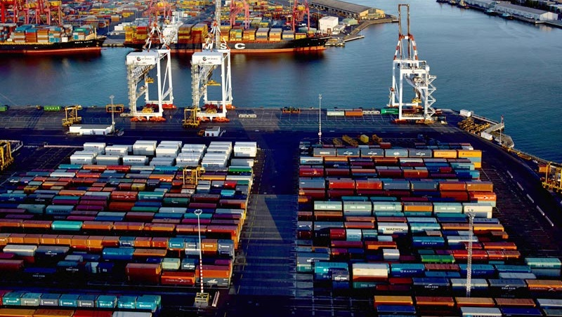
Water & ports: A sector in flux
West Coast ports dominate US container traffic, although labor issues in 2015 drove some shippers to the East Coast
Container traffic at major West and East Coast ports
TEU million
Overcapacity in containerized shipping (TEU capacity up 8.5%) creates a favorable rate environment for shippers but drives further consolidation
Overcapacity is also affecting dry bulk rates, but less so in the case of liquid bulk
Labor issues at West Coast container ports disrupted service in 2015, drove volumes to other ports, and altered seasonal patterns.
West Coast
Los Angeles, Long Beach, Seattle, Tacoma, Oakland
East Coast
New York and New Jersey, Virginia, Savannah, Charleston
+1%
+8%
Note: TEU is twenty-foot equivalent unit.
Sources: port statistics; A.T. Kearney analysis
Notes:
WATER AND PORTSEXPENDITURES REGISTERED OVER $47.6 BILLION, A 2.1% INCREASE OVER 2014
PORT STRIKES ARE AN INCREDIBLE DISRUPTOR WHICH RIPPLE ACROSS THE TRANSPORTATION LANDSCAPE AND IN 2015 FUELED GROWTH IN EAST COAST PORTS.
IN 2016 TREND REVERSING A BIT YTD WITH WEST COAST TRAFFIC UP 3% WHILE EAST COAST IS OFF 3%
WITH ONLY MODEST GROWTH BUT SIGNIFICANT OVERCAPACITY, CONTAINERIZED SHIPPING RATES WERE DEPRESSED IN 2015 AND HAVE REACHED HISTORIC LOWS IN 2016
Today, the supply of ships and their capacity is completely out of whack with demand. China’s economy has slowed and US GROWTH CAN ABSORB THE EXCESS CAPACITY IN THE NEAR TERM
HANJIN IS LIKELY NOT THE ONLY DISRUPTION TO BE EXPECTED
WHILE A STRONG DOLLAR WILL DAMPEN EXPORTS, IT SHOULD HAVE FAVORABLE IMPACT ON IMPORTS
IN SOME OF THE BIGGEST NEWS THIS YEAR THE PANAMA CANAL EXPANSION IN JUNE. HOWEVER, THE IMPACT IS STILL BEING DEBATED WITH MOST DISCUSSIONS TENDING MODEST FAVORABILITY TO EAST COAST PORTS

Slide 31
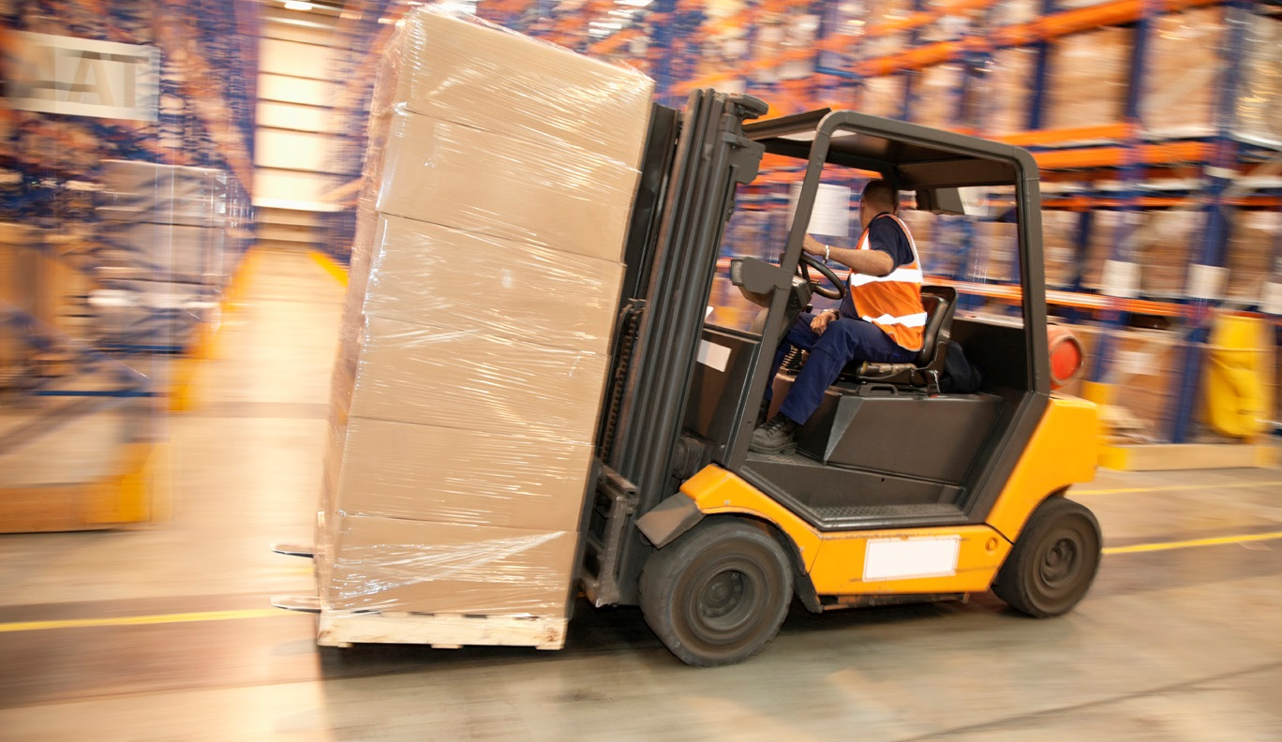
International freight forwarders:
A buyer’s market
The global freight forwarding market is expected to continue to grow steadily
Freight forwarders contract as much as 90% of air cargo capacity and 50% of water cargo capacity worldwide
Today, 25 global forwarders and thousands of small firms compete to fill excess capacity in air and water
Shippers are putting every lane out for bid to multiple suppliers, creating intense price competition
Global freight forwarding revenue
$ billion
+6%
+4%
Sources: TechNavio Insights: Global Freight Forwarding Market 2014-2018; A.T. Kearney analysis
Notes:
Freight forwarders contract as much as 90% of air cargo capacity and 50% of water cargo capacity worldwide
Today, 25 global forwarders and thousands of small firms compete to fill excess capacity in air and water
Shippers are putting every lane out for bid to multiple suppliers, creating intense price competition
NET IMPACT OF INTERNATIONAL FREIGHT FORWARDERS ON USBLC IS WELL UNDER $10 BILLION

Slide 32

Third-party logistics providers:
Driven by technology
The US 3PL market is experiencing consistent growth
US 3PL revenue
Approximately 11% of US logistics spend in 2015 was outsourced to 3PLs
The US 3PL market has grown by roughly 7% annually since 2009
Technology will continue to play a significant role with two trends: (1) the concept of a lead logistics provider enabled by a “control tower,” and (2) a cloud-based transportation management system
$ billion
+6.8%
Note: 3PL is third-party logistics provider.
Source: Armstrong & Associates
Notes:
Approximately 11% of US logistics spend in 2015 was outsourced to 3PLs
The US 3PL market has grown by roughly 7% annually since 2009
Technology will continue to play a significant role with two trends: (1) the concept of a lead logistics provider enabled by a “control tower,” and (2) a cloud-based transportation management system
As 3pl market grows, top providers are refining positioning to become one stop shops and targeting specific industries
In support of these goals, armstrong & associates reported that m&A spending reached nearly $18.9B in 2015

Slide 33

On the cusp of a new era:
Industry disruptors
Logistics industry disruptors
Technology adoption: the pace and breakthrough nature of technological innovation will heavily impact supply chain assets, processes, and people
Operational constraints: regulations and resource scarcity will influence the scope, scale, reach, and ability to perform transportation and logistics activities
Technology adoption
Macroeconomic trends
Autonomous vehicles, IoT
Artificial intelligence
“Uberization”
3D printing
Big data
Alternative fuels
Globalization
Volatile commodity prices
Climate disruption
Urbanization
Logistics
industry
Consumer requirements
Operational constraints
“Want it now”
Personalization
Millennial preferences
Omnichannel shopping
Aging consumer needs
Free trade agreements
Environmental legislation
Safety requirements
Resource availability
Note: IoT is the Internet of Things.
Sources: CSCMP; A.T. Kearney
Notes:
WHILE CAN NOT PREDICT THE FUTURE, USING SCENARIO PLANNING WE CAN EXPLORE THE KEY DRIVERS OF CHANGE AND THE RANGE OF FUTURES THESE DRIVERS MAY RESULT IN
EXPLORING THESE FUTURES WE CAN BEGIN TO DEVELOP STRATEGIES TO BE SUCESSFUL UNDER VARIOUS SCENARIOS, AND IDEALLY AS AN INDUSTRY UNDERTAKE ACTIONS TO INCREASE THE LIKELIHOOD OF OUR DESIRED FUTURE STATE
WITH THAT IN MIND WE RECENTLY INITIATED AN EFFORT TO EXPLORE POTENTIAL FUTURE SCENARIOS
BEGAN WITH 4 DIMENSIONS – MACROECONOMIC TRENDS, CONSUMER REQUIREMENTS, TECHNOLOGY ADOPTION, AND OPERATIONAL CONSTRAINTS
ULTIMATELY FOCUSING ON TECHNOLOGY ADOPTION AND OPERATIONAL CONSTRAINTS AS THE MOST RELEVANT DRIVERS CHANGE – PARTICULARLY THOSE WHERE WE AS AN INDUSTRY HAVE THE GREATEST OPPORTUNITY TO INFLUENCE
Technology adoption: the pace and breakthrough nature of technological innovation will heavily impact supply chain assets, processes, and people
Operational constraints: regulations and resource scarcity will influence the scope, scale, reach, and ability to perform transportation and logistics activities

Slide 34

On the cusp of a new era:
Potential scenarios
Strategic planning scenarios
Scenario 1: Cruisin’ Down the Highway – The technology market is truly open. Major motor carriers are able to deploy fully autonomous commercial vehicles for cross-country transport, helping to alleviate congestion. Supply chains are fully integrated. Shippers have more choice of supply and can capture value through better pricing and higher service. Regulators understand and trust technology.
Complete freedom
Scenario 3
Scenario 1
Middle of the
Road
Cruisin' Down
the Highway
Slow and incremental
improvements
Operational constraints
Major
breakthroughs
and high adoption
Technology adoption
Dead End Street
Stop Signs and
Red Lights
Scenario 4
Scenario 2
Complete constraint
Sources CSCMP; A.T. Kearney
Notes:
Scenario 1: Cruisin’ Down the Highway – The technology market is truly open. Major motor carriers are able to deploy fully autonomous commercial vehicles for cross-country transport, helping to alleviate congestion. Supply chains are fully integrated. Shippers have more choice of supply and can capture value through better pricing and higher service. Regulators understand and trust technology.

Slide 35
On the cusp of a new era:
Potential scenarios
Strategic planning scenarios
Scenario 2: Stop Signs and Red Lights - Fierce operational constraints, including a devastating driver shortage, high fuel prices, and regulatory barriers to new technologies such as autonomous vehicles and robotics, deeply affect the transportation industry. Due to regulations, only the strongest and most easily adoptable technologies flourish—and only in the hands of those able to invest for the long term.
Complete freedom
Scenario 3
Scenario 1
Middle of the
Road
Cruisin' Down
the Highway
Slow and incremental
improvements
Operational constraints
Major
breakthroughs
and high adoption
Technology adoption
Dead End Street
Stop Signs and
Red Lights
Scenario 4
Scenario 2
Complete constraint
Sources CSCMP; A.T. Kearney
Notes:
Scenario 2: Stop Signs and Red Lights - Fierce operational constraints, including a devastating driver shortage, high fuel prices, and regulatory barriers to new technologies such as autonomous vehicles and robotics, deeply affect the transportation industry. Due to regulations, only the strongest and most easily adoptable technologies flourish—and only in the hands of those able to invest for the long term.

Slide 36
On the cusp of a new era:
Potential scenarios
Strategic planning scenarios
Scenario 3: Middle of the Road - Status quo. Automation capabilities improve incrementally, even with an unconstrained environment. Warehousing facilities are regional or central, as shippers maximize the use of transport to keep total ownership costs down. Customers have a few more choices, but no distinctive competitor emerges. Regulators are business-friendly and rational.
Complete freedom
Scenario 3
Scenario 1
Middle of the
Road
Cruisin' Down
the Highway
Slow and incremental
improvements
Operational constraints
Major
breakthroughs
and high adoption
Technology adoption
Dead End Street
Stop Signs and
Red Lights
Scenario 4
Scenario 2
Complete constraint
Sources CSCMP; A.T. Kearney
Notes:
Scenario 3: Middle of the Road - Status quo. Automation capabilities improve incrementally, even with an unconstrained environment. Warehousing facilities are regional or central, as shippers maximize the use of transport to keep total ownership costs down. Customers have a few more choices, but no distinctive competitor emerges. Regulators are business-friendly and rational

Slide 37
On the cusp of a new era:
potential scenarios
Strategic planning scenarios
Scenario 4: Dead End Street - Regulators are inflexible and hinder the entrepreneurial spirit of the US market. The limited technological advancement and increased cost of regulatory compliance shakes out supply markets, creating higher costs for consumers with limited service differentiation. Great expectations remain unmet.
Complete freedom
Scenario 3
Scenario 1
Middle of the
Road
Cruisin' Down
the Highway
Slow and incremental
improvements
Operational constraints
Major
breakthroughs
and high adoption
Technology adoption
Dead End Street
Stop Signs and
Red Lights
Scenario 4
Scenario 2
Complete constraint
Sources CSCMP; A.T. Kearney
Notes:
Scenario 4: Dead End Street - Regulators are inflexible and hinder the entrepreneurial spirit of the US market. The limited technological advancement and increased cost of regulatory compliance shakes out supply markets, creating higher costs for consumers with limited service differentiation. Great expectations remain unmet

Slide 38
The Advisory Committee on Supply Chain Competitiveness
The ACSCC started with 2 questions…
The Committee represents the first time that America’s businesses and the Federal Government came together in a whole-of-government way to identify the biggest issues that impact our supply chain competitiveness – and come up with solutions.
How do freight and infrastructure policies affect the competitiveness of U.S. businesses?
What should the Federal Government do to improve these policies?

Slide 39
Subcommittee Structure
Chair: Rick Blasgen
Finance and Infrastructure
Trade and Regulatory
Subcommittee Chairs: Shawn Wattles and Jevon T. Jamieson
Workforce Development
Subcommittee Chair: Leslie Blakely
Freight Policy and Movement
IT & Data
Subcommittee Chair: Tiffany Melvin
Subcommittee Chair: Rick Gabrielson
Subcommittee Chair: Anne Strauss-Wieder

Slide 40
US State of Logistics
Logistics Costs $1.408 t
% of GDP 7.85%
Trans Costs $889 b
Inv. Carrying $427 b
Transportation = 63% of total logistics spend!
Source: CSCMP’s Annual “State of Logistics®” Report

Slide 41
Since 2006…
Logistics Costs have risen 20%
Average annual increase = $26b
2015 increase was $35b
Also….
As a % of GDP, Logistics expense went from 8.4% to 7.8%, a reduction of 7%.
Since 1990, the reduction is 30%!

Slide 42
Global Comparison of Logistics Expenditures
U.S.
7.9% GDP
Economy
Higher Output--GDP
Better use of resources
Multi-use Infrastructure
Businesses
Market Access
Market Integration
Cost Efficiency
Consumers
More Goods and Services
Wider Availability
Lower Prices/Income
Asia 17% GDP
China 18% GDP
Europe 13% GDP
India 13% GDP
Japan 11% GDP
Mexico 14% GDP

Slide 43
What keeps the CEO up at night?
Shareholder Value
Revenue
Cash Flow
Profitability
Market Share
3G? (Kraft Heinz – Unilever $143B?)

Slide 44
When Supply Chains Work Well
Wal-Mart's supply chain management success is improving productivity in the United States:
The effects of the company's supply chain innovations on the retail industry led to a 3.1 percent decline in overall consumer prices.
Consumers spent $263 billion LESS than they would have if Wal-Mart were not around! That translates to $895 per person, or $2,329 per household.

Slide 45
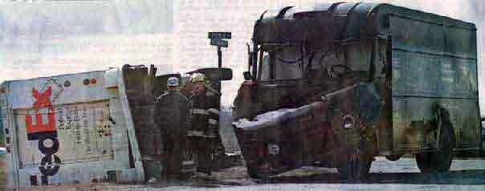
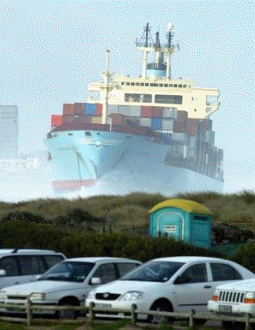
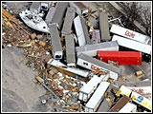
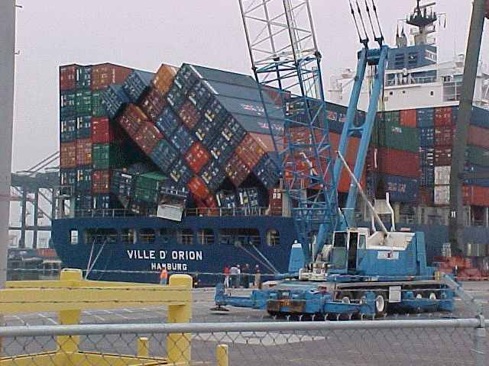
When Supply Chains Don’t Work So Well

Slide 46
SCM Has Strategic Profit Impact
A study by Georgia Tech showed that a company’s stock price drops 8% when the company experiences a glitch in its supply chain.
A study at Miami University showed that when a company adopts a new supply chain innovation the company’s stock price increases.
A study by Bain & Company showed that companies employing sophisticated supply chain methods enjoyed 12 times greater profit than companies with unsophisticated methods.
Wall Street: New found respect for SCM. In one SCM MBA program in the US, 21/32 grads received job offers from Investment Banking firms because of the importance of SCM to their clients.

Slide 47
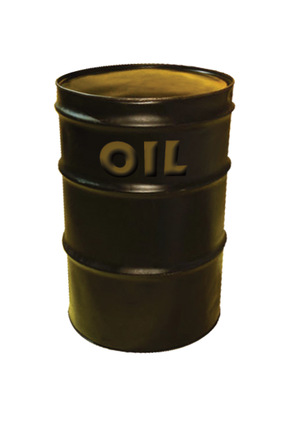

Decisions
$30
Different Decisions?
$145

Slide 48
Admin impacts?
More production in the USA
Energy self-sufficiency
Rationalized tax code
Border adjusted tax
Fewer superfluous regulations
Technology – driven change accelerates
Revitalized military

Slide 49
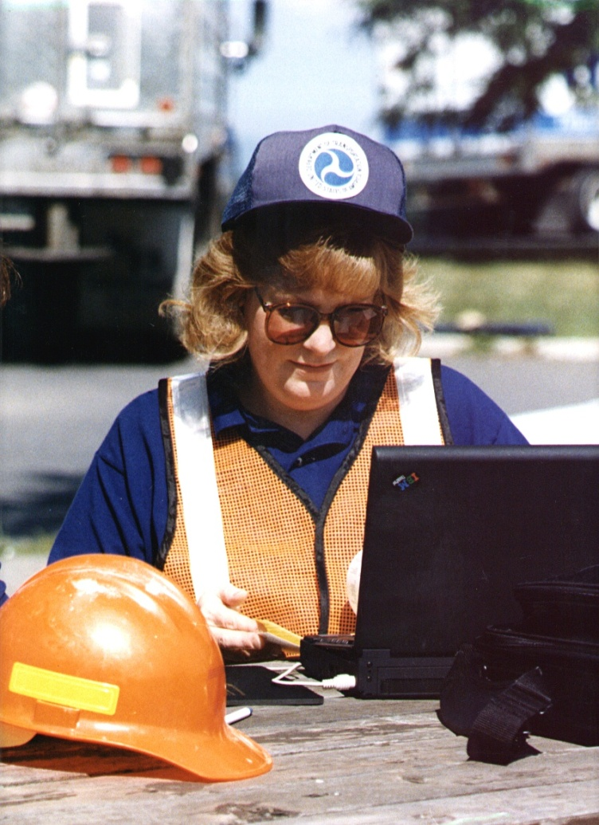
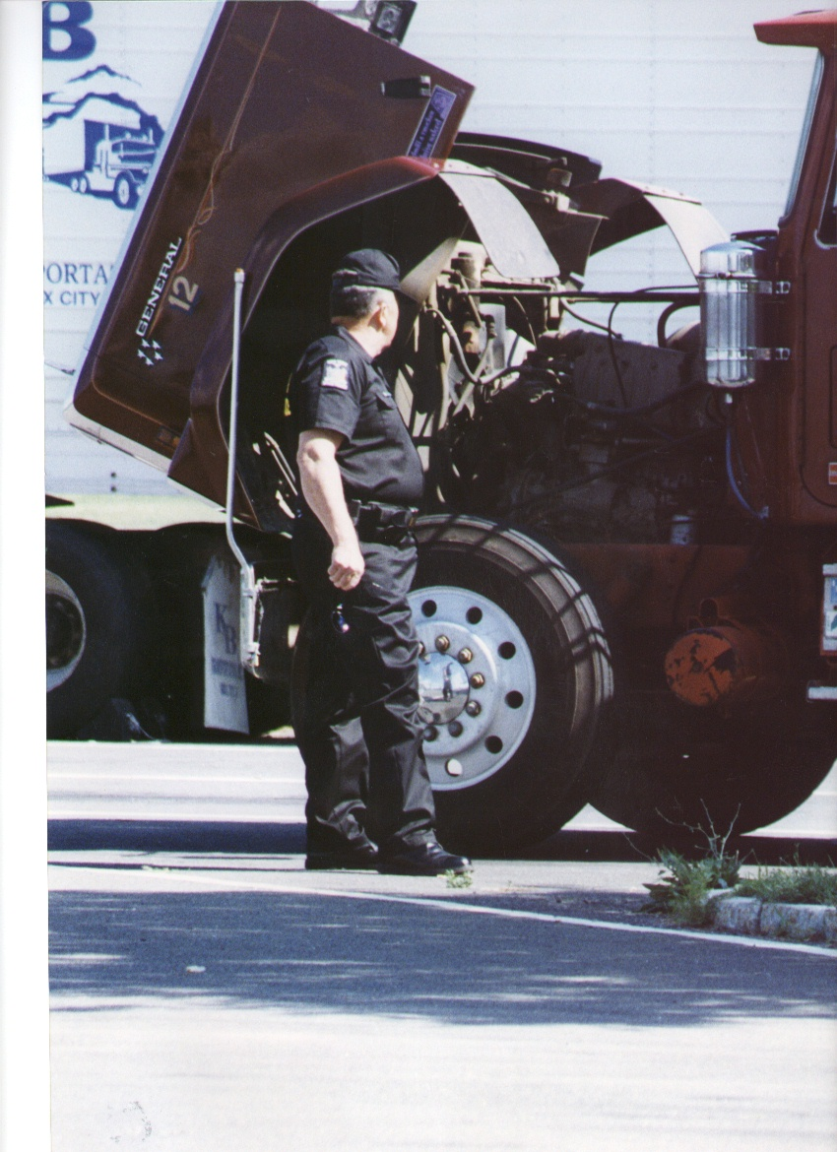
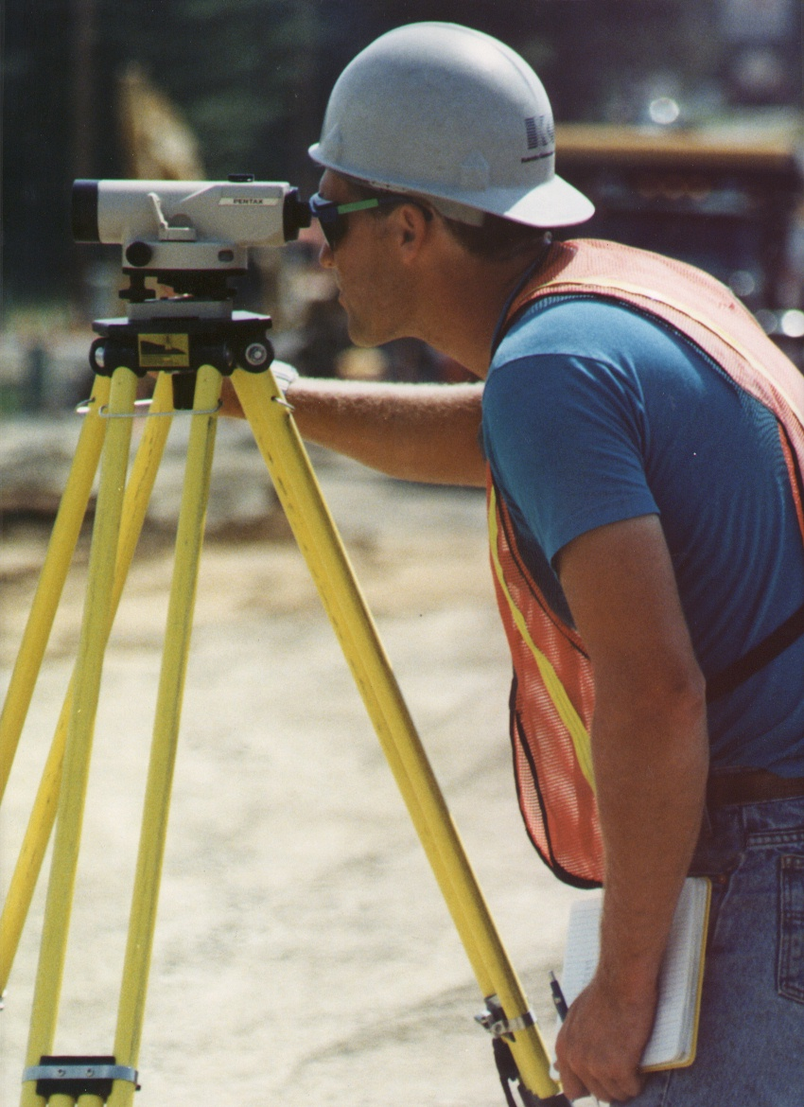
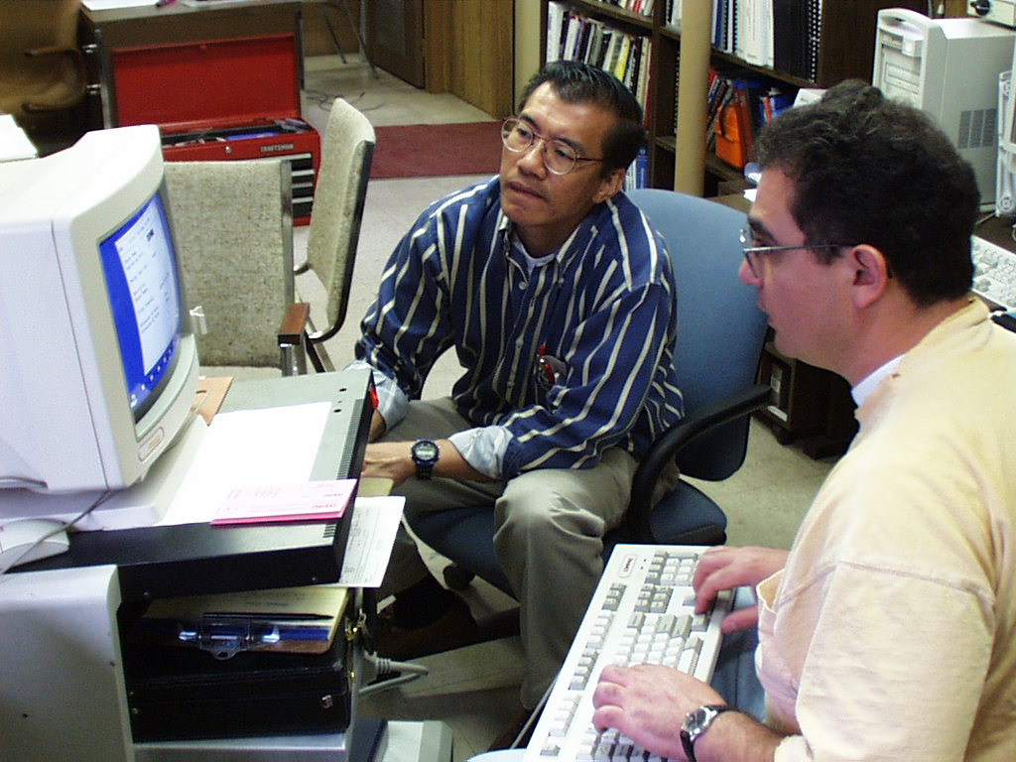
Key Workforce Challenges

Slide 50
Transportation Workforce
Getting to 2022
USDOT provides over $51 billion annually in surface transportation funding.
  $1 billion in infrastructure investment creates 13,000 jobs.
Transportation sector employers (air, transit, highway, maritime, rail, trucking) will need to hire 4.6 million workers through 2022.
  Add 417,000 due to industry growth
  Hire 4.2 million workers to fill vacancies created by separations (retirement, transfer, etc.)
    Approximately 2 million of the vacancies are in trucking.

Slide 51
Key Workforce Challenges
40-50% of the transportation workforce will retire in the next 10 years
Fewer people are going into key transportation fields
Competition for workers from other industries
Challenge of reaching women and minorities

Slide 52
U.S. Birth Rates
RETIRING
AVERAGE
HIRING
1940 1950 1960 1970 1980 1990 2000
Baby Boomers
Generation X
Generation Next

Slide 53
Notes:
(Past) The very rapid labor force growth over the 1970s reflected two dramatic changes: the baby-boom generation reached working age, and it became more common for women to work outside the home.
Since the 1970s, the labor force has continued to grow, but at a slower rate.
(Future) A substantial slowdown in the pace of labor force growth is projected for the years 2015-25, as the baby-boom generation retires.

Slide 54
“The Perfect Storm”
SMALLER HIRING POOL
RETIREMENTS
NEW SKILL REQUIREMENTS

Slide 55


What skills will be required for success?
Art or Science?

Slide 56
What are the skill development needs of companies today?
Forecasting and planning
Project management
Problem solving
Modeling
Data analytics
Technology
Leadership
Collaboration
Communication
Teamwork
Multi-cultural perspective
Relationship management
Creativity & Innovation

Slide 57

Traditional Supply Chain
Functional Career Path
Executive Level Senior Level Advisory Level Staff Level Entry Level
Demand/Supply
Planning
Procurement
Manufacturing
Global Logistics
Fulfillment

Slide 58
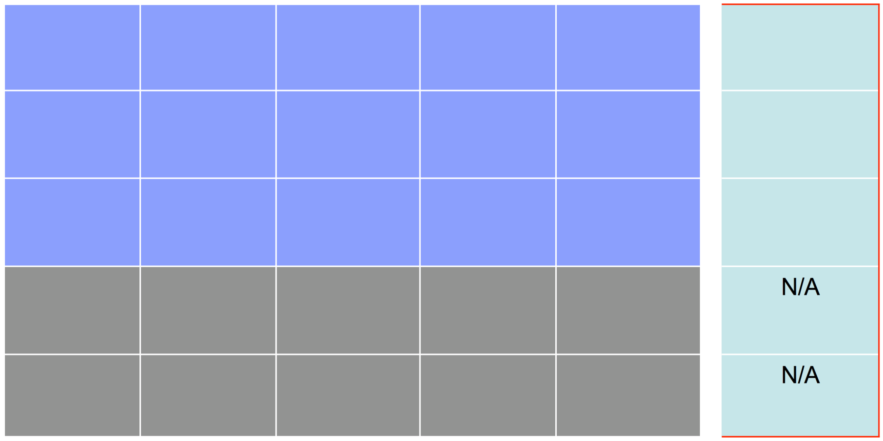
Leading Edge SCM Career Path
Corporate Executive Level
SCM Consulting Level SCM Sr. Level SCM Advisory Level ISC Staff Level ISC Entry Level
Experiences outside of ISC
Demand/Supply
Planning
Procurement
Manufacturing
Global Logistics
Fulfillment
Supply Chain
Management

Slide 59
The Future of Supply Chain Professionals
Work within the Supply Chain
Inventory Management
Procurement
Transportation
Customer Service
Warehousing
Production Planning & Manufacturing
Materials Planning
  Proficient competencies
  Technical
  Managerial
  Leadership
  Must have excellent interpersonal skills
  Ability to sustain collaborative relationships

Slide 60
Top management is interested
in what we do!
But we must communicate
more effectively.

Slide 61


Financial Dimensions of SCM
Customer service level
Sales
minus
Gross Margin
Logistics efficiency;
Procurement savvy
Cost of Goods Sold
Net
Profit
minus
Logistics efficiency
Optimal network
Variable Expenses
plus
Total Expenses
Return on Assets
Using Logistics assets
effectively and efficiently
Fixed Expenses
divided by
Just enough for
desired service level
Inventory
plus
Fast order cycle time
Right product, no damage
Accounts Receivable
Total Assets
plus
Effective use of logistics
assets/outsourcing
Optimal network
Fixed Assets

Slide 62
What wild and crazy things are going to happen in supply chain management?

Slide 63
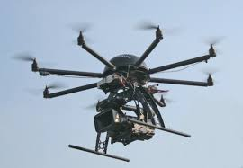
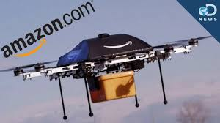
Delivered right to your front door!!
“Chipotle and Alphabet Plan Drone Delivery of Burritos at the Virginia Tech campus”

Slide 64
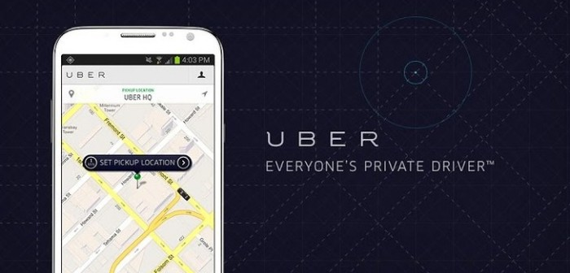
“Uber introduces fleet of self-driving cars in Pittsburgh”

Slide 65
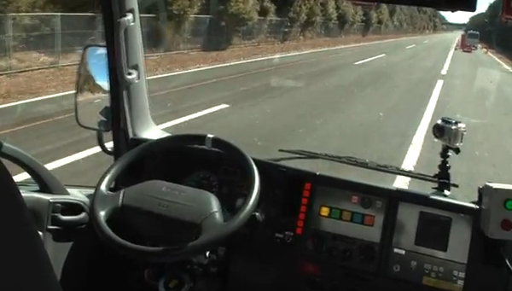
Driverless Vehicles?

Slide 66
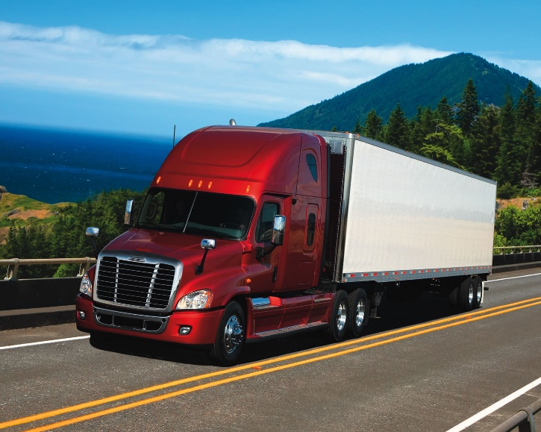
August 2016 – “Uber-owned Otto to offer freight hauling services using autonomous trucks in 2017”
February 2017 –”Self-driving trucks from Uber startup Otto questioned by California regulators”

Slide 67
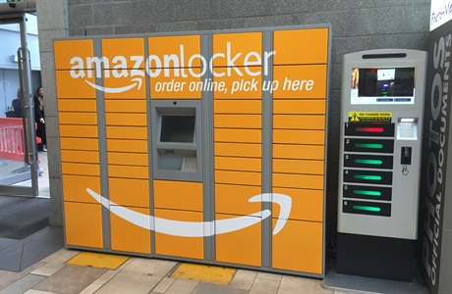

Slide 68
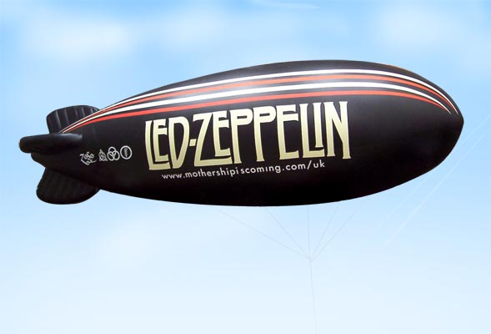
Floating warehouses?
“Amazon wants to create an “airborne fulfillment center” (AFC) to hover at altitudes of around 45,000 feet and spit out delivery drones with customers’ orders.”

Slide 69
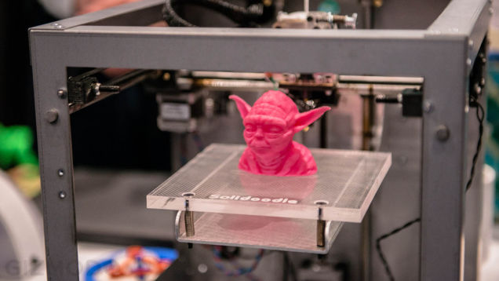
3-D Printing

Slide 70

Virtual Reality

Slide 71

Artificial Intelligence?
Elon Musk says “humans must become cyborgs to stay relevant.”
If humans want to continue to add value to the economy, they must augment their capabilities through a “merger of biological intelligence and machine intelligence”. If we fail to do this, we’ll risk becoming “house cats” to artificial intelligence.
Mark Cuban: Robots will ‘cause unemployment and we need to prepare for it’

Slide 72
SCM Conducts a Symphony
We matter!
Suppliers
Customers
Sales
SCM Pro
Manufacturing
Procurement
Information Tech
Marketing

Slide 73
Summary
  The discipline is a corporate necessity, yet can be a growth vehicle – a revenue generating engine.
  We improve the financial position of companies and economies.
  Our stature and credibility is increasing.
  Supply chain professionals need to develop cross functional skills and a global mindset to maximize opportunities in the world.
  SCM is growing, and you are in a terrific position!

Slide 74
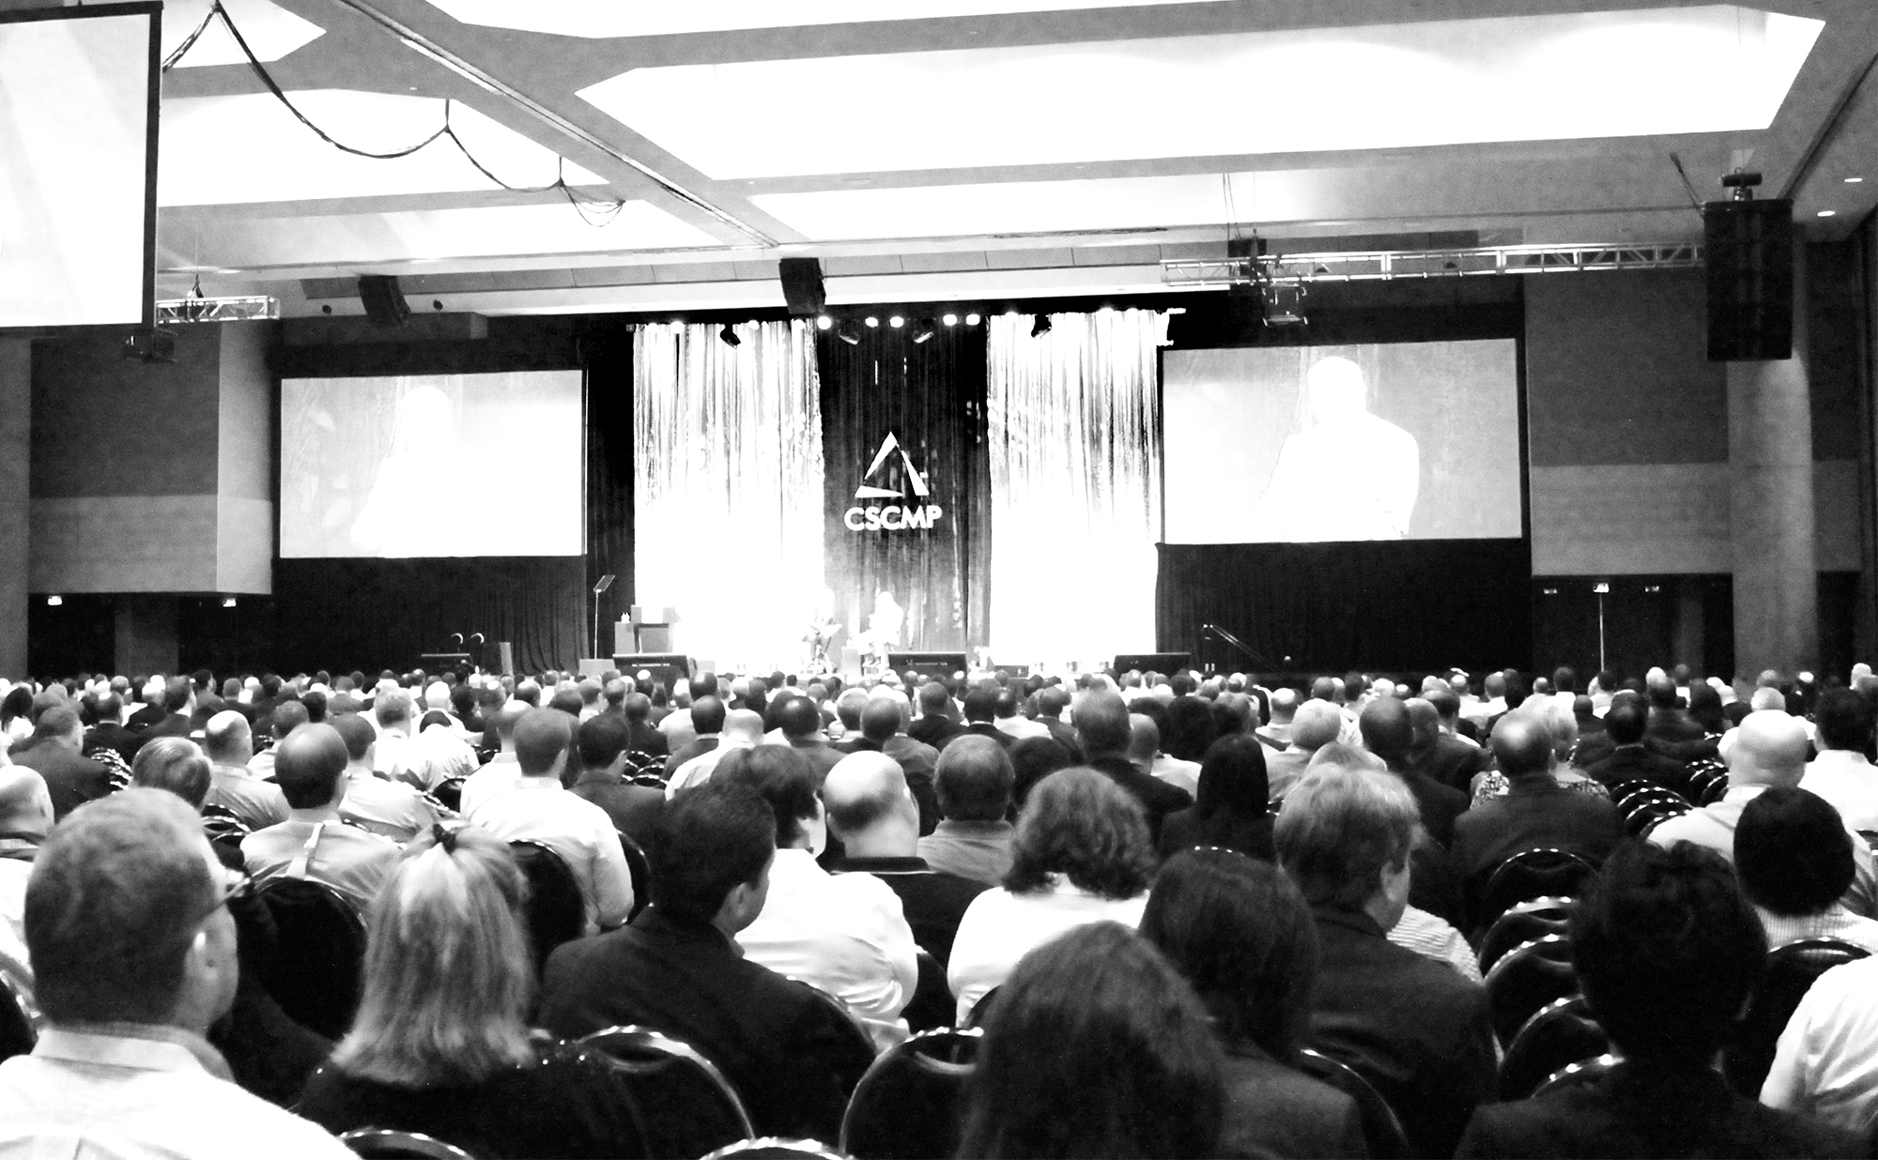

Register today! cscmpconference.org
Join us in Atlanta, Georgia for CSCMP’s 2017
Annual Conference, September 24-27
3000⁺
120⁺
25⁺
SCM professionals under one roof
hours educational content
hours dedicated networking

Slide 75
CSCMP’s Evolving Role
  Goal
    Connect, Educate and Develop the world’s Supply Chain Professionals!
  Supply Chain Concierge Service
  Join the Community – visit CSCMP.org!

Slide 76
“If people are committed to maintaining yesterday, they are not available to create tomorrow”
Peter Drucker

Slide 77
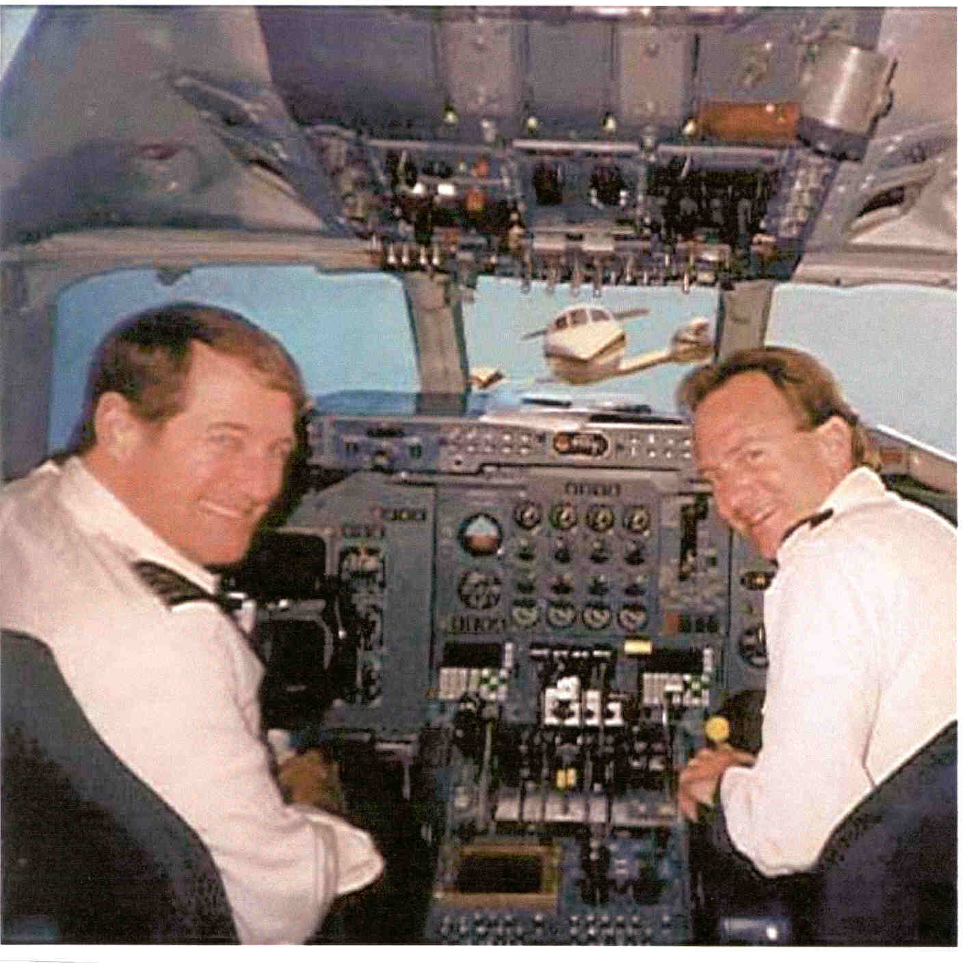

Slide 78
Sometimes, we have to learn to forget

Slide 79
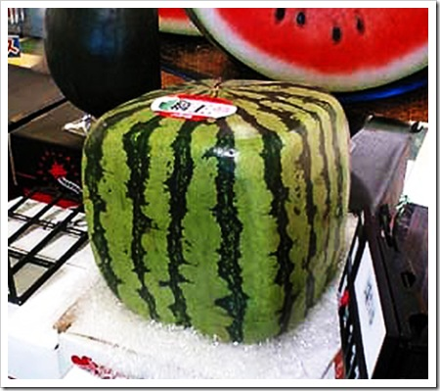
Innovation!
Be Creative in your Response to Supply Chain Problems

Slide 80

Our Challenge……..
It will not be easy, but . . .
It can happen.

Slide 81
Thank you!

